Slide 1
SECURE DATA HIDING IN IMAGES USING STEGANOGRAPHY
CAPSTONE PROJECT
Presented By: R.S.PARINITHA
Student Name : R.S.PARINITHA
College Name: ANAND INSTITUTE OF HIGHER TECHNOLOGY
Department : B.Tech ARTIFICIAL INTELLIGENCE AND DATA SCIENCE

Slide 2
OUTLINE
Problem Statement
Technology used
Wow factor
End users
Result
Conclusion
Git-hub Link
Future scope

Slide 3
Problem Statement
With the increasing reliance on digital communication, data security has become a major concern. Traditional encryption methods ensure data confidentiality but may attract unwanted attention from hackers. Steganography provides a more discreet way of securing data by embedding secret information within digital images. The goal of this project is to develop a secure, efficient, and user-friendly steganographic system that allows users to hide sensitive data within images while maintaining the image's quality and security

Slide 4
Technology used
The technology used for this project is a combination of image processing, cryptography, and steganography. Specifically, the following techniques are employed:-
Image Processing:
The project utilizes image processing algorithms to analyze and modify the image pixels.-
Cryptography:
Cryptographic techniques, such as encryption and decryption, are used to secure the hidden data.
Steganography:
Steganographic methods, like least significant bit (LSB) substitution, are employed to hide the encrypted data within the image.

Slide 5
Wow factors
Dual Encryption Mechanism:
Combining encryption (AES, RSA) with steganography for double-layer security.
Adaptive Steganography:
Dynamically adjusts data embedding based on image complexity to avoid detection.
Noise-Resistant Data Extraction:
Ensures data retrieval even if the image undergoes compression or slight modifications.
Mobile and Web Compatibility:
Can be implemented as a cross-platform application for better accessibility.
Steganalysis Resistance:
Includes countermeasures against steganalysis tools that detect hidden data.

Slide 6
End users
* Government and Defense Organizations:
Secure transmission of classified information.
* Journalists and Whistleblowers:
Safe communication without detection
* Businesses and Enterprises:
Protect sensitive corporate data from industrial espionage.
* General Users:
Personal privacy protection in digital communication.

Slide 7

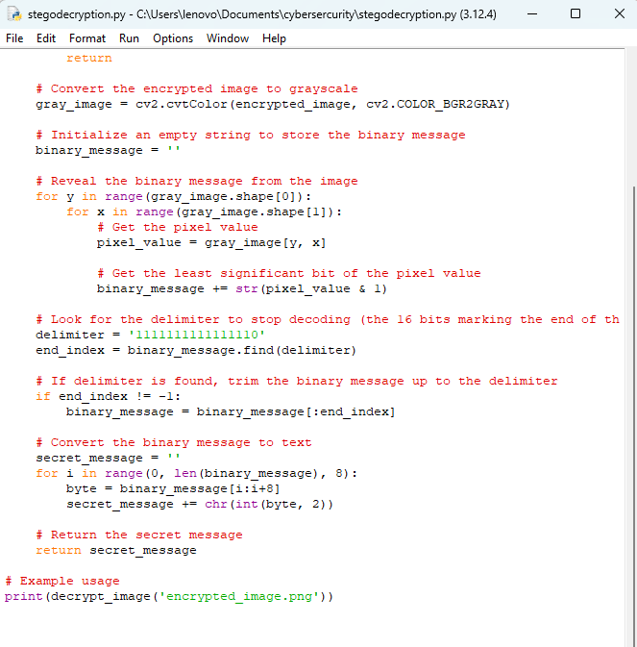
Results

Slide 8
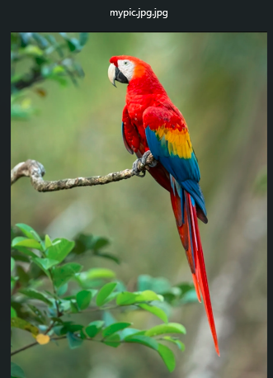
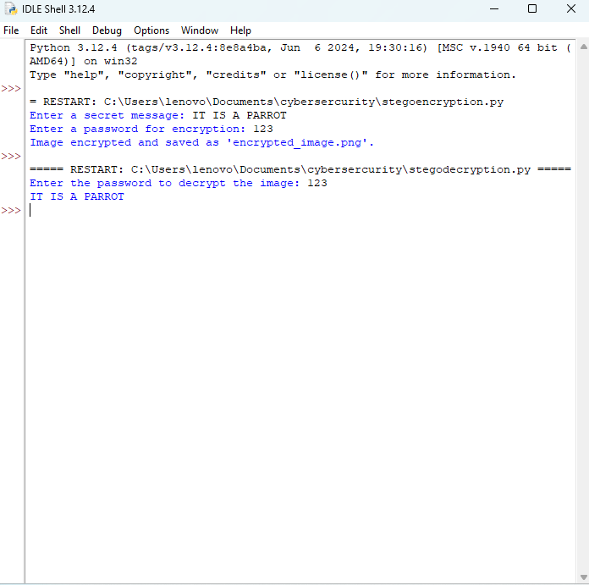
Results

Slide 9
Conclusion
Steganography provides an effective method for secure data hiding, complementing traditional cryptographic techniques. The implemented system ensures data confidentiality without drawing attention, making it a valuable tool for secure communication. The combination of encryption and steganography enhances security, making unauthorized access extremely difficult.

Slide 10
GitHub Link
https://github.com/Parinitha1506/CyberSecurity-Project.git

Slide 11
Future scope(optional)
AI-Based Adaptive Steganography:
Using machine learning to optimize embedding techniques based on image content.
Blockchain Integration:
To enhance security and traceability of hidden data.
Real-Time Video Steganography:
Extending the system to hide data in video files for higher capacity.
Cloud-Based Secure Communication:
Enabling encrypted steganographic communication over cloud platforms.
Resistance to Advanced Steganalysis:
Developing techniques to counter AI-based steganalysis tools.

Slide 12
THANK YOU

